Slide 1

Problems on Confidence Interval 2009

Slide 2
Reference
Data
Youtube
Code

Slide 3
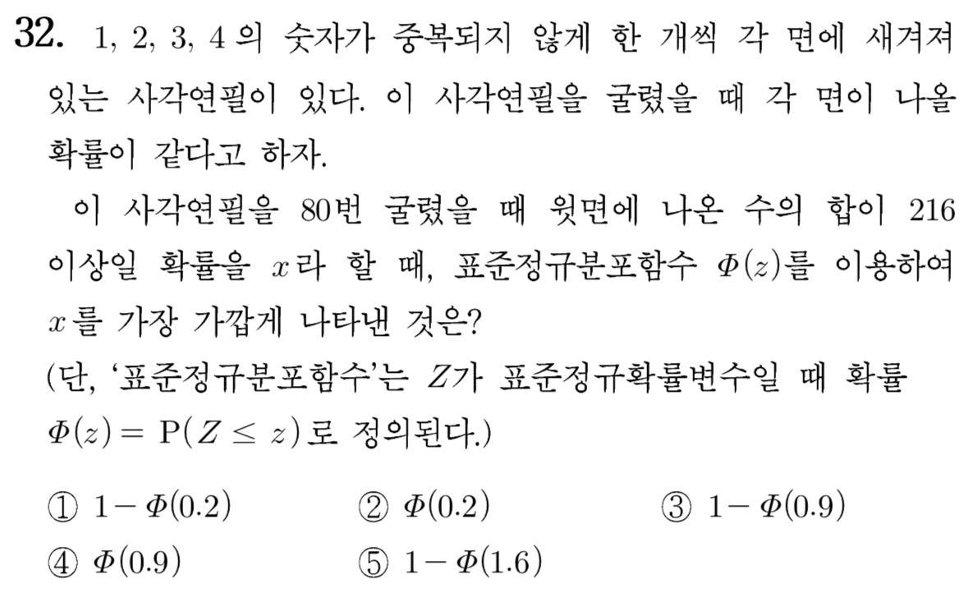
[2009]

Slide 4

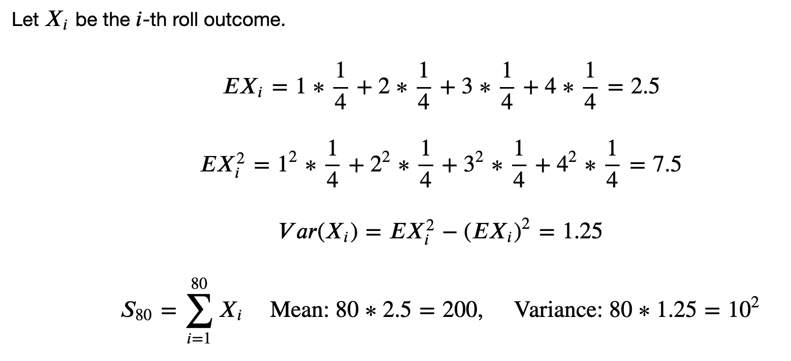


Slide 10

